Slide 1
Columbia University WEAI business procdures
2021

Slide 2
Columbia University WEAI business procdures
Grab your cup of coffee and we will all get through this together!

Slide 3
Catering / Events
Travel
Purchasing at columbia
Payments at Columbia

Slide 4
Catering / Events
Travel
Purchasing at columbia
Payments at Columbia

Slide 5
on campus events
Delivery and drop-off of food:
No contract is required.
Delivery and food drop-off on campus can be paid on the P-Card. If the food is dropped off some place other than campus, payment must be made against an invoice only.
We recommend for delivery/ drop off service that tips are 15%, however, anything over 20% will not be reimbursed.
Catered events that include wait staff:
A purchase order is required.
If alcohol is served, a NYC Temporary Catering Permit is also required for each day of the event.
Please see the Columbia University master list for preferred venues.

Slide 6
Deliveries on campus
The following list of vendors are WEAI preferred caterers, and it is strongly encouraged to have food delivered for events from one of these venues (please note that a purchase order is not required when food is being dropped off):
Zai Lai
Between the Bread
Dig Inn Seasonal Market
Milano Market
Morton Williams
Brownie’s Café
V&T Restaurant
Westside Market
Chef Alexander

Slide 7
off campus events
Gatherings of 30 or more attendees:
Require a formal event contract which must be fully executed in advance of the event. Purchasing must approve so be sure to build in lead time (approval from central purchasing can take anywhere from 2-3 weeks).
Gatherings of 29 or fewer attendees:
No contract required (unless requested by venue). If a contract is required it must be signed by the venue as well as purchasing. Please have the venue sign their contract first, and then Columbia will review for signature.
Events held at homes of faculty, staff or students:
Contracts are not reviewed by Purchasing but signed by the homeowner – invoice can be processed via AP but supplemental approval is needed.
PLEASE ALSO SEE HOTEL AND EVENT CONTRACTING GUIDE.

Slide 8
Letters of credit
Letters of Credit (LoC) can be requested for gatherings of 29 or fewer attendees and delivery of food on campus from preferred local vendors. Please work with WEAI finance to request a letter of credit. The following vendors accept letters of credit:
http://www.pisticcinyc.com/
http://vtrestaurantpizzeria.com/
http://www.appletreenyc.com/location
http://www.dinosaurbarbque.com/
https://www.milanomarketnyc.com/
http://marlowbistro.com/
http://vtrestaurantpizzeria.com/
https://www.diginn.com/
https://www.martinbrotherswine.com/
http://www.lemondenyc.com/
https://www.pabadebakery.com/
https://www.foodincnyc.com/

Slide 9
Meal allowances
$25 breakfast, $35 lunch, $75 dinner. Note: External speakers, now only $100 ($150).
$150 for entertainment meals (fundraising, recruitment, speaking engagements) involving external parties.
Any meals that exceed the above listed amounts will not be reimbursed unless prior approval has been requested and received.
For expenses where there are 10 or less people, a list of attendees (and their affiliation) needs to be provided. For gatherings over 10+ we need the total number of attendees to be listed.

Slide 10
Meal allowances (cont)
Please note that alcohol only will not be reimbursed. A food item must be purchased in conjunction with the alcohol. Any alcohol expenses must also be segregated.
Amounts exclude taxes and tip. Please make sure tip does not exceed 20% when dining at a restaurant as any amount over 20% will not be reimbursed.
Use of per diems on non-grant accounts (only in instances of international travel to destinations where local custom or culture makes it difficult to obtain receipts).
Per Diems are allowed for domestic and international trips with overnight stay.
If you select per diems, you must use the rate for the entire day.

Slide 11
Additional approval(S)
Meals that require attendance by an employee’s spouse, significant other, and/or dependent.
Expenses for meals or entertainment conducted in private homes.

Slide 12
Catering / Events
Travel
Purchasing at columbia
Payments at Columbia

Slide 13
Arranging travel – WTI
Columbia University has contracted with World Travel, Inc. (WTI) to assist Columbia travelers in making business travel arrangements, consistent with Columbia’s travel policies, cost considerations, and preferences.
WTI travel services include self-service via the Concur Online Booking Tool (OBT) and assisted service over the phone via WTI Travel Counselors for reservations, including air, rail, lodging, and car rental, producing itineraries, e-tickets, and receipts. In order to book travel with WTI, travelers must maintain a travel profile that contains personal information.
Please review the Transaction Fee Chart for a complete description of Business Travel transaction fees booked on Concur Travel or with a WTI Travel Counselor over the phone.
To speak with a Columbia University designated Travel Counselor, please call: 1-855-961-0313
If calling from outside the United States please call: 1-484-948-2514

Slide 14
Booking domestic travel
To learn how to book domestic flights, hotels, and car rentals in Concur Travel, watch the following video:
Video: Using Concur Travel to Purchase Domestic Air, Hotel, and Rental Car
Users should review the following chart for a complete description of transaction fees booked on Concur Travel or with a WTI Travel Counselor over the phone: Transaction Fee Chart

Slide 15
Booking International travel
When a reimbursement is for international travel, please make sure that all documentation is uploaded showing that all of the approvals for that travel have been given.
The traveler should have received an email from Global Travel, showing that the request has been reviewed and approved by the EVP for Arts and Sciences and the Provost. This email should be uploaded with the expense report in Concur.
If you are planning Columbia-related international travel during Fall 2021, please visit the International Travel Restrictions for travel request requirements.
You must register a trip before departing. Please visit ISOS and follow the instructions listed on the page to register the trip.
Additionally, please fill out the ISOS Pre Trip Itinerary Review Form in order to receive the correct approvals for your trip.

Slide 16
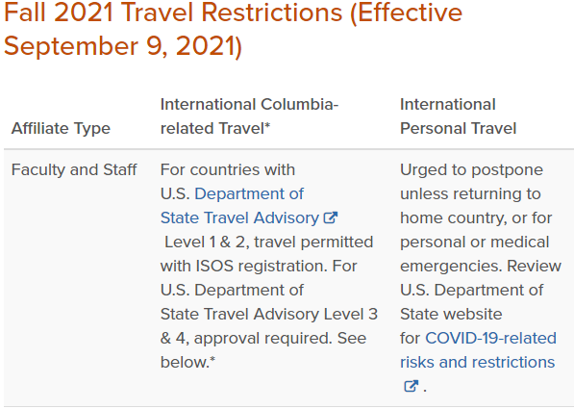
*international travel restrictions*
Columbia-related international travel is currently restricted. Please find the requirements for requesting Columbia-related international travel here.
These international travel restrictions are in addition to the requirements of the International Travel Planning Policy.

Slide 17
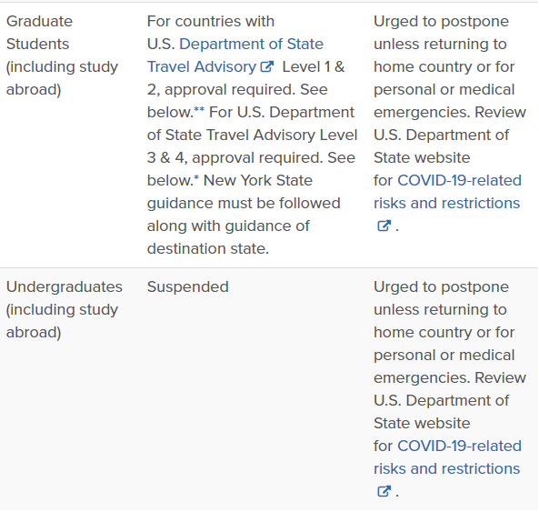
*international travel restrictions* (cont.)

Slide 18
Booking travel as delegate
Users can assign delegates to act on their behalf and book their travel. To act as delegate and book travel on behalf of others, the delegate must select the user on their Profile under "Acting as other user."
Users should follow this job aid for guidance on how to assign and manage their delegates:
Job Aid: Assign and Manage Delegates
Student and guest travel
By default, Students and Guests (Outside Parties) do not have access to Concur. To assist Students and Guests with travel, a designated Staff member can book on their behalf. Only designated Travel Arrangers can book travel for Students and Guests (Outside Parties).

Slide 19
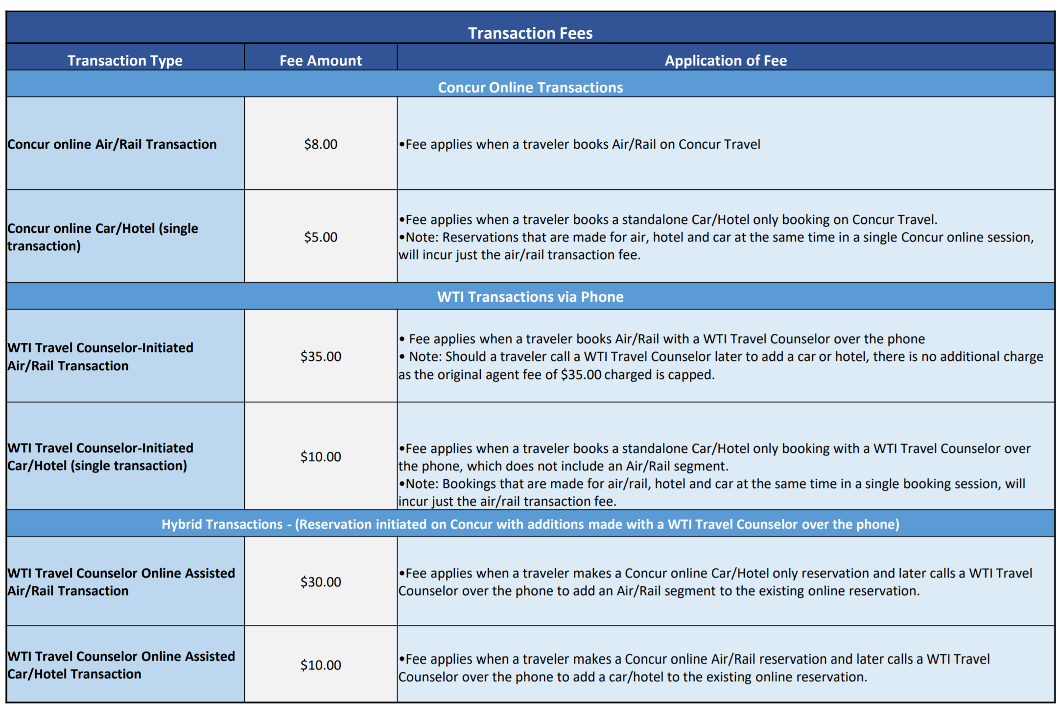
WTI booking FEES

Slide 20
Arranging travel- Faculty & Staff
Faculty and staff can book/ pay for travel directly and get reimbursed using the Concur System. When using federal grant funds, be sure to follow the guidelines for the Fly America Act. If seeking an exception, please complete the fly America act exception memo.
If expenses related to travel are purchased and paid for in advance (airfare, train, bus etc.), the traveler may submit the expenses for reimbursement before the actual travel. Otherwise, please submit all other expenses after the travel is complete.
When completing/ submitting a Concur Travel Expense form, please only submit one trip per (TE) and any business expenses (separate from the actual trip) must be submitted in another Concur Business Expense (PE).

Slide 21
Supplemental approval (Travel)
Flights or business class travel by air (flights in excess of 5 hours or medical need). If booking business class, traveler must submit documentation for the same trip in economy class at the time of purchase.
First or business class travel by rail/bus (not including Amtrak’s Acela train).
Lodging exceeding $350 per night domestic and $400 (USD) per night international excluding tax by no more than 50%.
Appreciation given for lodging in a private residence.
Short-term rental accommodations.
Reimbursed travel extended beyond the minimum days required for business purposes.
Required travel by an employee’s spouse, significant other and/or dependent (Note: May be taxable).

Slide 22
Airfare classes
The University expects that the majority of air travel will be at the lowest available fare. In addition, the majority of University research grants only allow for travel in coach or economy class. Any fare within the economy cabin will be allowed (economy, main cabin economy, economy plus, extra legroom within economy etc.). Travelers may travel in business class as an exception in the following cases:
If the flight has an in flight time in excess of 5hrs
Documented medical condition requires it
*Supplemental approval is required for business or first class airfare. Additional amount from economy ticket must be segregated as well. You must also print out a comparable economy class ticket at the time of purchase and segregate any difference. Business and First Class travel requires CFO approval in advance of the trip.

Slide 23
BOOKING RAIL TRAVEL

Slide 24
Catering / Events
Travel
Purchasing at columbia
Payments at Columbia

Slide 25
When do you need a Purchase order(PO)
Central Purchase Orders: Central Purchase Orders must be used for purchases in excess of $500 and are non-UwPA’s. Central PO’s must also be used for the procurement of all services.
PO: Auto source PO’s may be used for the purchase of goods and services from University-wide Purchasing Agreement (UWPA) vendors in amounts approved by University Purchasing.
P-Card: P-Card is the preferred purchasing mechanism for most goods and minor equipment valued at $2,500 or less.

Slide 26
University wide purchasing agreements (Uwpa) vendors
UwPA's represent suppliers that have been awarded a University contract based on a competitive or negotiated process managed by Central Purchasing. These suppliers maintain a “Preferred” supplier status at Columbia, which affords the University community easier access to these suppliers through designated representatives and websites as well as the ability to place orders at higher transaction limits without Central Purchasing review or approval. Additional benefits of UwPA's are enhanced service levels and competitive pricing. The use of UwPA's is strongly recommended at Columbia and can be found through the UwPA Guide. Advantage to use – only one quote and directly sourced- no need for Purchasing review.
Click here for UWPA vendor List

Slide 27
Purchase Orders & contracts
The following examples are goods/service providers that require a Purchase Order prior to commencing work (please note this list is not all inclusive. Please see the purchasing website for a complete listing): There are different requirements for many types of service providers so be sure to work with the Finance office to determine which forms are needed.
Graphic Designer
Video Editors
Photographer
Leasing/ Rental
Software/ Licensing
Translator (on-campus)
Interpreter (on-campus)
Catering (on-campus)
Business Consultant
Strategic Consultant
General Research

Slide 28
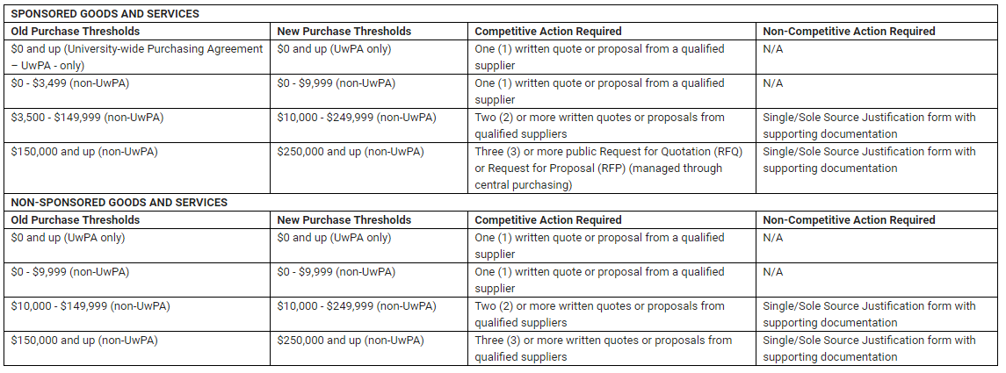
Purchase Orders thresholds

Slide 29
Purchase Order Required documents
These are some of the documents that may be required for a purchase order. This can vary by service provider. Please see the purchasing guide for more details.
Quote(s)
Client List- list of current service provider customers
Resume or Company Brochure
Service Provider Agreement (if applicable)
Photography Rider (if applicable)
Scope of Work
Independent Contractor Certification- all sole proprietors or individual contractors require an Independent Contractor Certificate
Services Compliance Checklist

Slide 30
Purchase Order Required documents
Certificate of Insurance (COI)- if vendor is providing service on-campus “The Trustees of Columbia University in the City of New York” must be listed as the certificate holder and under description of operations it should read “The Trustees of Columbia University in the City of New York, its trustees, officers, agents and employees as additional insured”.
Sole/ Single Source Justification- if only one source is available with the required specifications.
*Please note service providers such as consultants must include their travel expenses on the invoice as it is work related and therefore taxable to them. Additional information and/ or documents may be requested depending on the type of goods and/ or service.

Slide 31
Contracts (agreements)
Contracts nor any kind of agreement should never be signed by a staff, faculty member or student. All contracts must be signed by a designated personnel from the Purchasing department. Please submit contracts well in advance. Contracts require minimally 7-10 business days for review. Departments are notified as soon as the contract or agreement is fully signed; a copy must be attached to the invoice when submitting for payment processing.
Certain venues have negotiated master agreements with Columbia University, and therefore, can be finalized much quicker. Departments are strongly encouraged to hold events at these venues.

Slide 32
Promotional Items
You must use a promotional vendor that is licensed by the University to use trademarks in manufacture of emblematic product. Please find a list of approved vendors to use for promotional items here. In addition, please also note that the P-Card can be used for purchases $2,500 and below from a University approved vendor. Anything above that amount will require a purchase order.

Slide 33
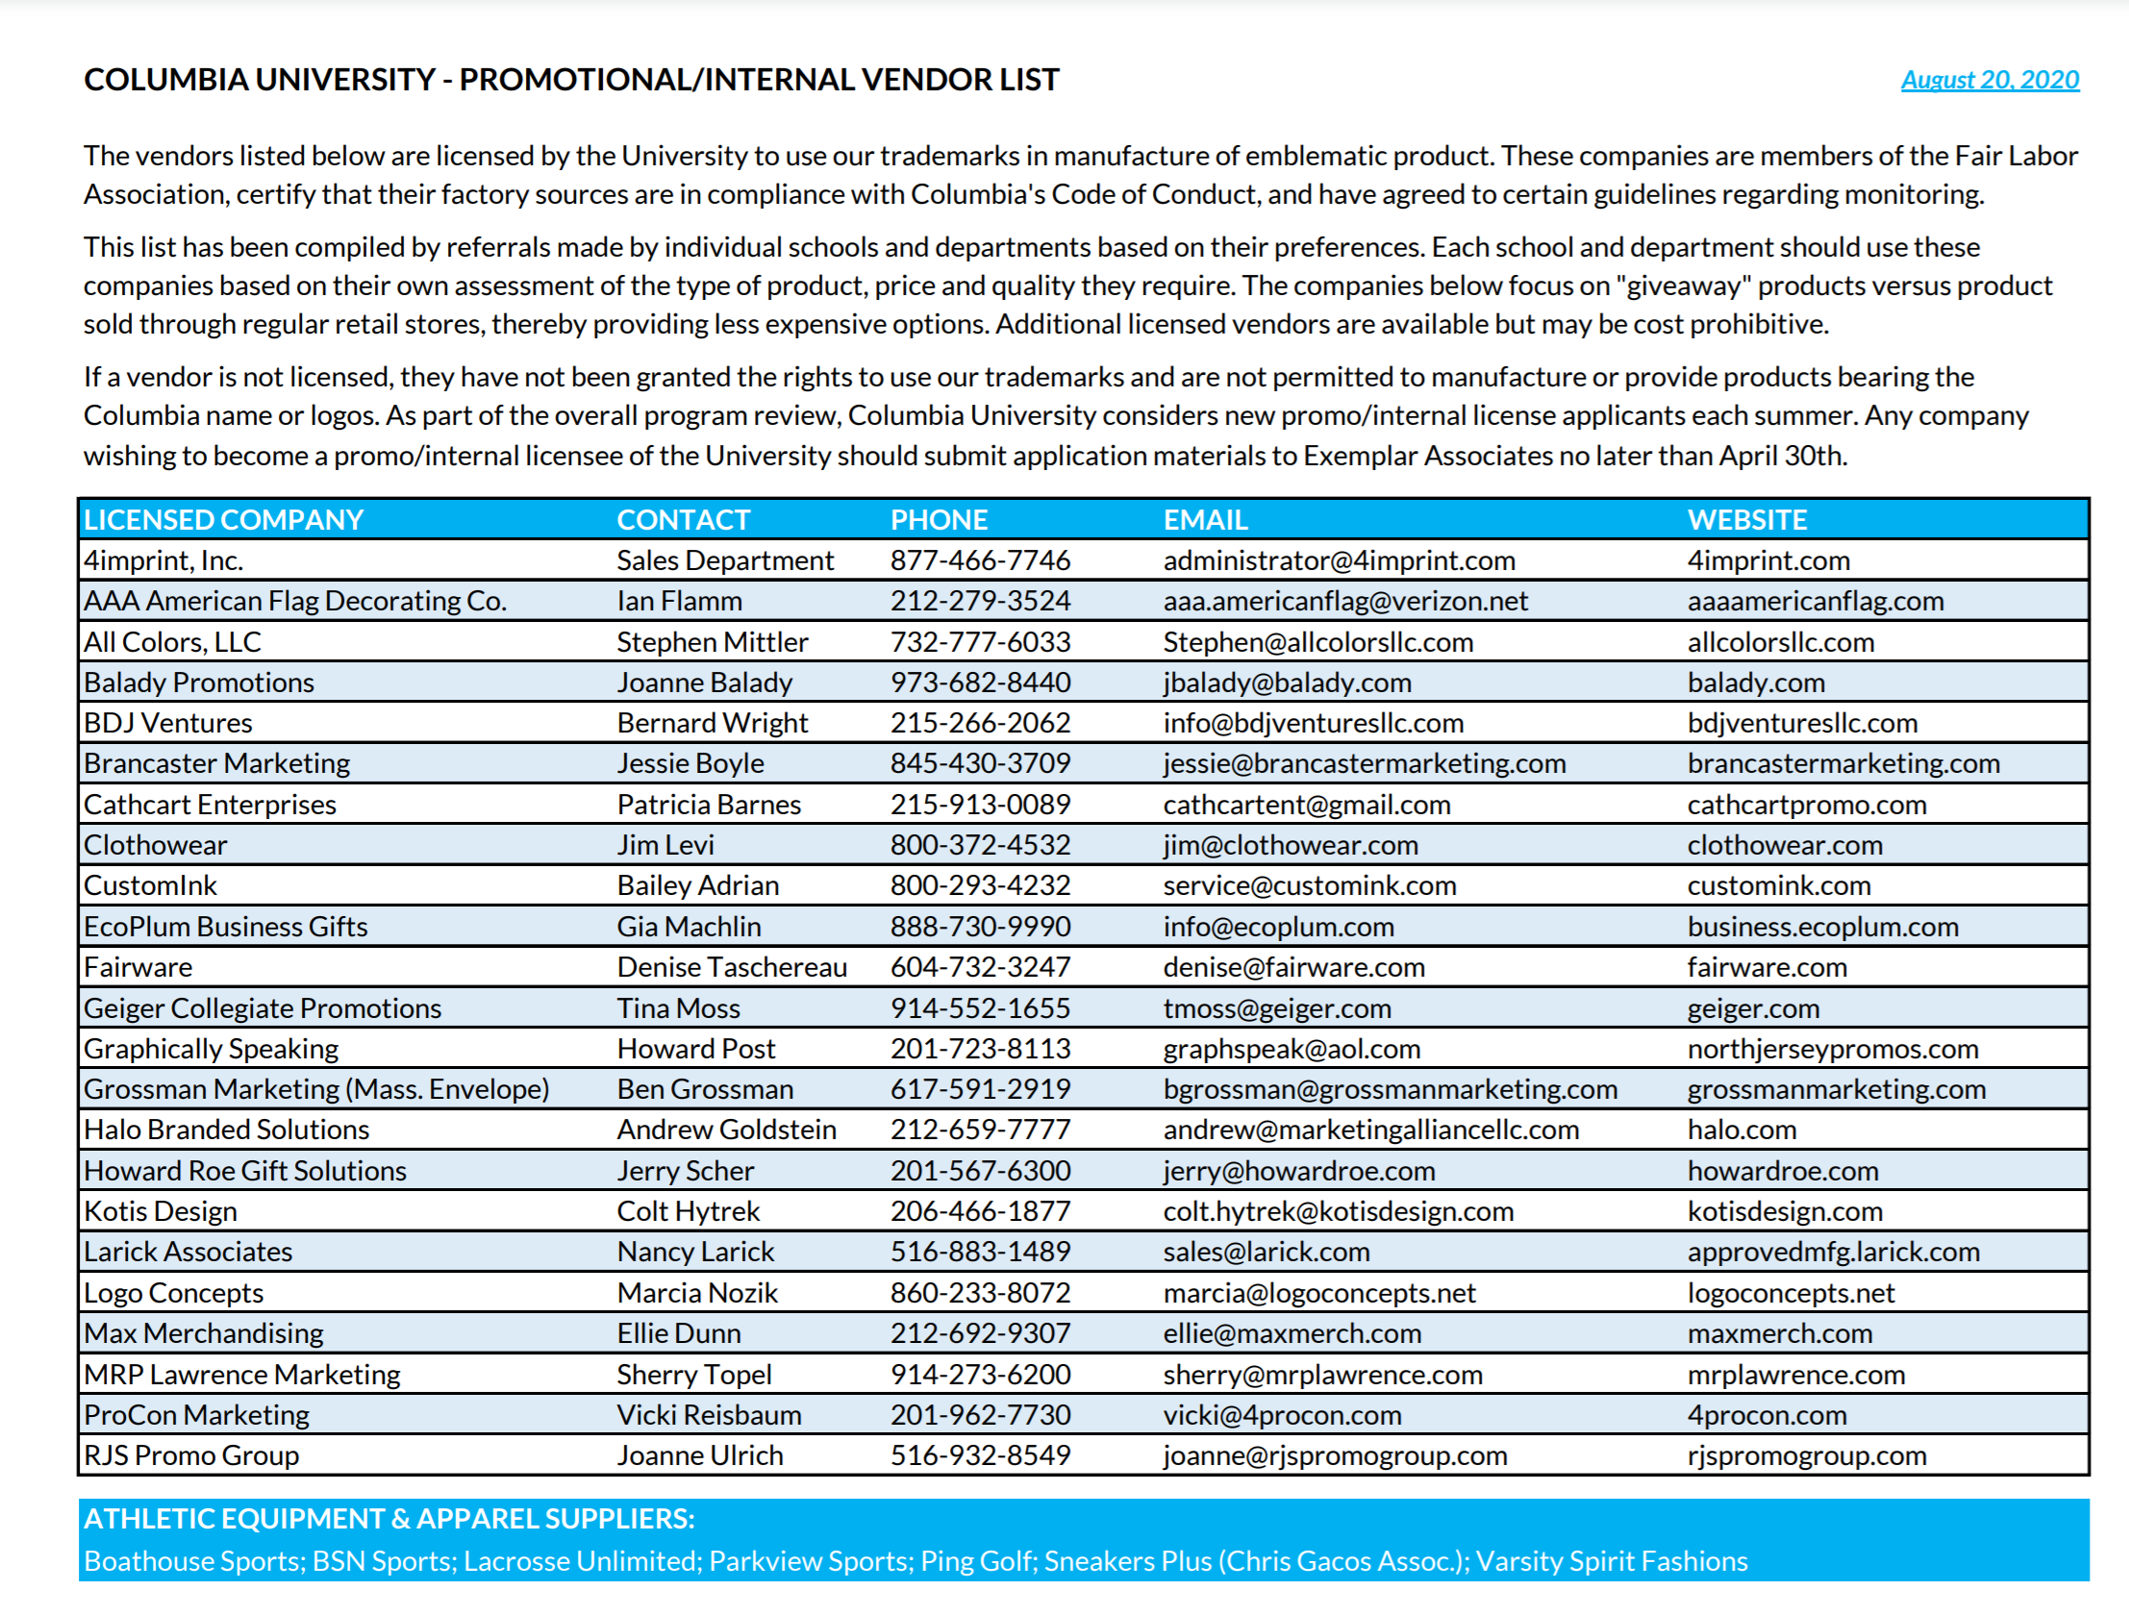

Slide 34
Catering / Events
Travel
Purchasing at columbia
Payments at Columbia

Slide 35
Accounting for expenses at columbia
ARC (Accounting and Reporting at Columbia) is the Columbia University accounting system, and the “chartstring” is used to identify the funding source of the expense. It is important to be familiar with the chartstrings and budgets that you manage as you will often need to provide this information when making purchases or doing transfers between departments.

Slide 36
Chartstrings
Example of Chartstring: COLUM-65205-4109102-GENRL-EN004755-01-25000-00000000

Slide 37
Setting up a new vendor
Vendor Management is responsible for creating and maintaining all payee and supplier profiles utilized to process transactions in Accounting & Reporting at Columbia (ARC). The Business Office assists members of WEAI in their efforts of requesting the creation of new vendor profiles for domestic and international vendors (payees/suppliers).
Requirements:
Goods and/ or service providers are required to complete a web based vendor questionnaire, and are advised to sign up for ACH direct deposit. Vendor Management will send email notifications to the vendor, directing them to log in with a username and temporary password to complete the requirements.
Departments are encouraged to follow up with the vendor to ensure the requirements are completed in a timely manner and emphasize to the vendor that no transaction (payment) can be initiated until they complete all requirements, submit required documentation, or respond to any questions.

Slide 38
Requirements (U.S. Individuals and entities)
Person | Entity
Required Information | Required Information
Payment description (service type) | Payment description (service type)
Full Name (legal name) | Full Name (legal name)
Address (same as W-9) | Address (same as W-9)
Email address | Email address
Phone number | Phone number
Required Documents: W-9 Form | Required Documents: W-9 Form
*If Columbia has not done business with the U.S. vendor/ guest before, please submit the documentation noted above to the WEAI finance office.

Slide 39
Requirements (International Guests/Organizations)
Person | Entity
Required Information | Required Information
Payment description (service type i.e. honorarium) | Payment description (service type i.e. honorarium)
Service Location (country) Full Name | Service Location Name of entity (beneficiary owner)
Address (Do not use P.O. Box) | Address (Do not use P.O. Box)
Email address | Contact Name
Phone number | Contact email address Contact phone number
Required Documents: W-8 BEN Also, if services performed in the U.S.: Copy of passport Copy of Visa Copy of entry stamp, I-94 (or ESTA Receipt) | Required Documents: W-8 BENE Form
*If Columbia has not done business with the foreign vendor/ guest before, please submit the documentation noted above to the WEAI finance office.

Slide 40
Direct deposit/ach request- employee or student
You can view and update the method for how you receive Accounts Payable (AP) Reimbursements for travel and business expenses. Your AP Reimbursement method is related to your Direct Deposit settings for Payroll with one of the following defaults, which you can change as desired:
If your Payroll is not setup with Direct Deposit, your AP Reimbursement defaults so you are paid by check.
If your Payroll is set up with a single Direct Deposit account, your AP Reimbursement defaults so that you are paid using the same Direct Deposit account.
If your Payroll is set up with multiple Direct Deposit accounts, your AP Reimbursement defaults so you are paid using the method marked as “Remaining Balance” in the Direct Deposit module.
To view the full Job Guide, Click Here:

Slide 41
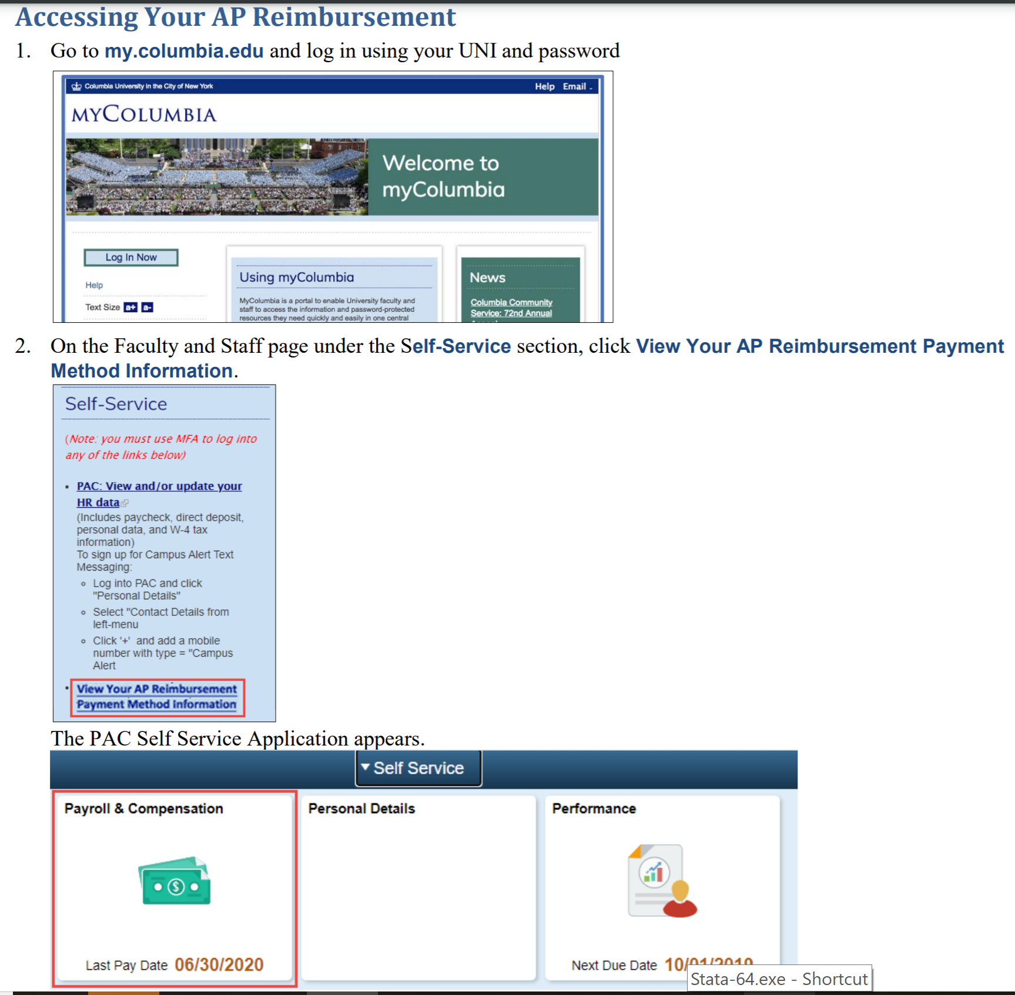

Slide 42
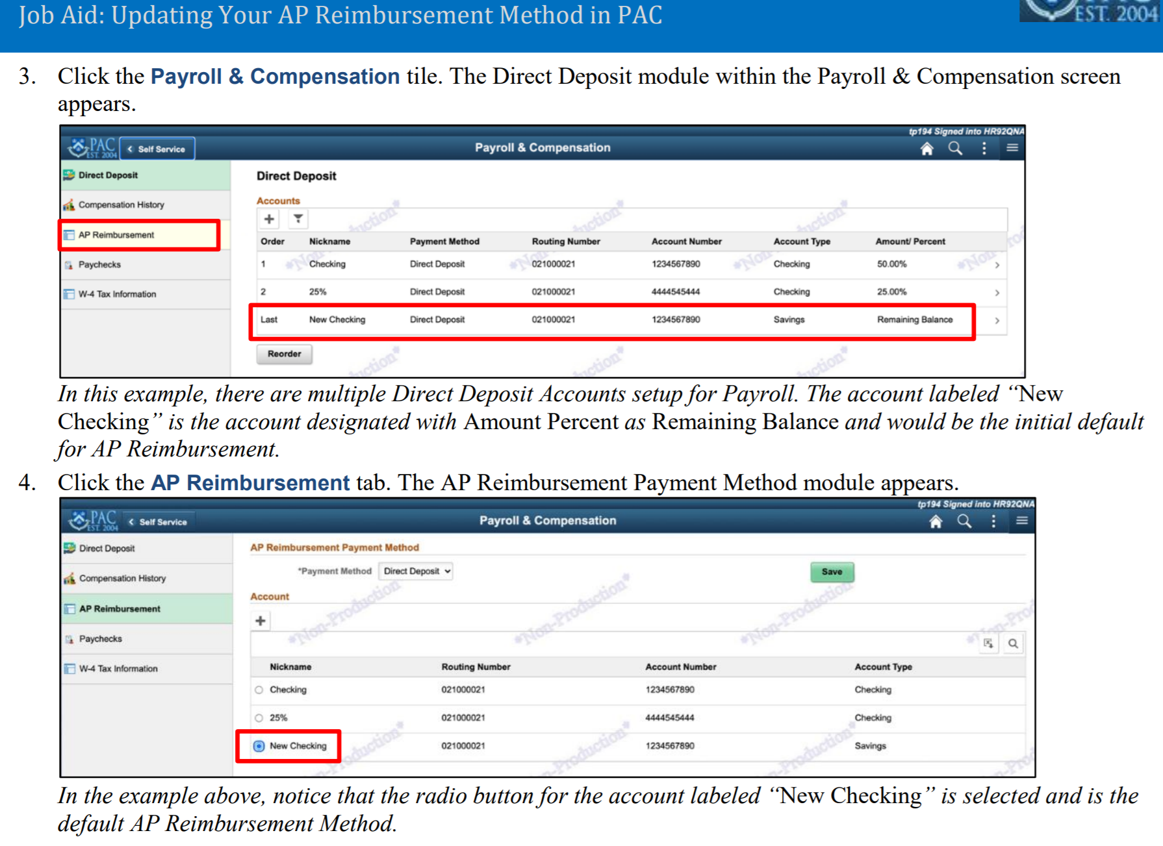

Slide 43
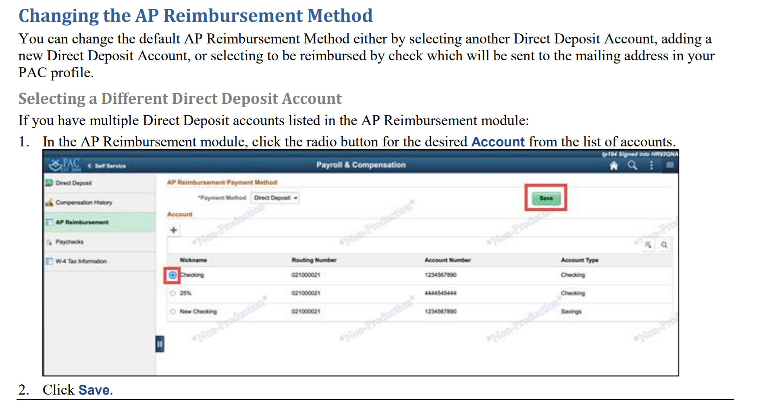

Slide 44
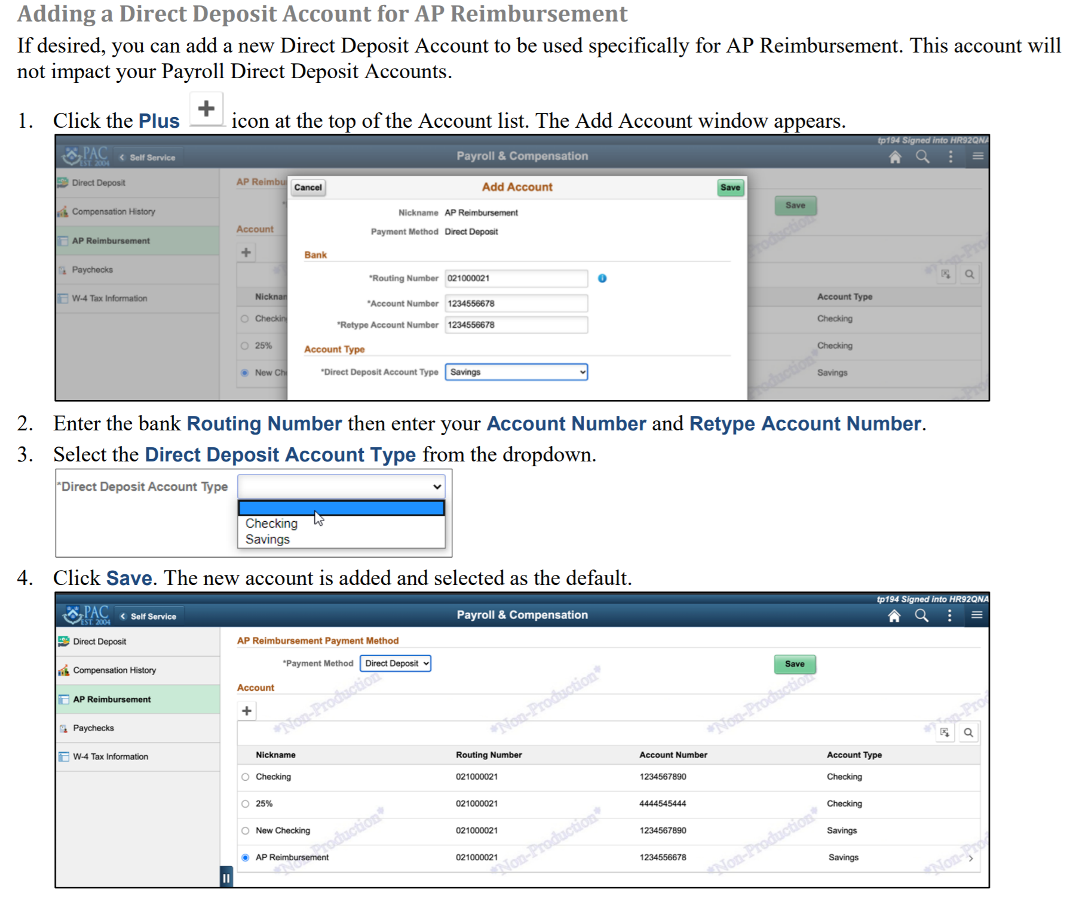

Slide 45
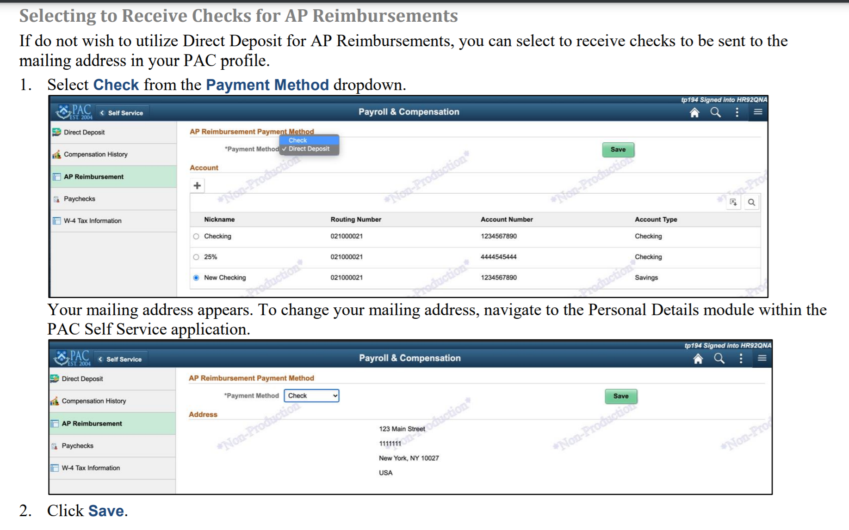

Slide 46
ACH request- Outside party/ supplier
Once a payee or supplier has completed Vendor Management requirements and a VENDOR ID is created in ARC, they can request to receive direct deposit payments (strongly recommended) as opposed to paper checks, by following the instructions below. To obtain a VENDOR ID, visit the Vendor ID Lookup site or email the Business Office with the vendor details.
How to complete a ACH Modification:
1. Go to the Vendor Payee/Request Web Form: https://forms.finance.columbia.edu/vendor-request/
2. Enter Supplier ID#: 0000XXXXXX, and click "Submit"
3. Select your vendor name as it appears, and click "Edit"
4. The type of modification will be " DIRECT DEPOSIT (ACH) MODIFICATION "
5. Follow the prompts to submit the request
6. You will then receive an email with a temporary login and password in order to provide your banking account information
7. Please provide the "Request ID" number so that we can follow up on the request internally to rm3557 and nh2047

Slide 47
How to add wire instructions – foreign vendor
How to complete a Wire Modification:
1. Go to the Vendor Payee/Request Web Form: https://forms.finance.columbia.edu/vendor-request/
2. Enter Supplier ID#: 0000XXXXXX, and click "Submit"
3. Select your vendor name as it appears, and click "Edit"
4. The type of modification will be "Wire"
5. Follow the prompts to submit the request
6. You will then receive an email with a temporary login and password in order to provide your banking account information
7. Please provide the "Request ID" number so that we can follow up on the request internally to rm3557 and nh2047
Wire Transfer is a disbursement method used to pay international individuals or entities with an international bank account.

Slide 48
Honorarium
“An honorarium payment is a gratuitous payment to a lecturer or a professional person outside the University community (not a University faculty or staff member) as an expression of thanks.
It is taxable income and is reportable to the Internal Revenue Service.” Remember that an Honorarium is a “thank you” payment, usually to an outside party. It is NOT a payment for an invoice, to an agent, nor to a student.

Slide 49
Honorarium
An honorarium, prize or award processed by check or direct deposit must be submitted on a Check or Wire Request Form along with the following supporting documents:
An official letter on your department’s letterhead, addressed to the payee, reflecting the amount of the honorarium or award. Signature of department authorizer is required.
Event flyer, agenda, email or invitation reflecting the business purpose of the activity.
*Payment request to be processed via Wire Transfer must be submitted along with the Wire Request Form.
*Please see instructions about paying an honorarium to a foreign vendor

Slide 50
Making an Honorarium payment to a foreign guest
How to cover the 30% tax on an Honorarium Payment (to a Foreign National):
For a standard honorarium payment of $300.00 USD please increase the amount in ARC to $428.57 after receiving notification from A/P if you would like to cover the 30% tax.
How did we get the $428.57 total?
.7x = $300.00
x = $428.57
Or, if the amount is greater, say a $500.00 honorarium payment:
.7x = $500.00
x = $714.29
The tax will be deducted from this $428.57 total so that the voucher is released in the net total of $300.00.
* If it is done abroad, it is not subject to tax so ignore the gross payment calculations.

Slide 51
Payment to a goods or service provider
Goods and/ or service providers must issue a document requesting payment. This document is called an “invoice” and should include all information related to the purchase or service provided. The invoice must be addressed to “Columbia University”. Vendors are strongly encouraged to include an invoice number on every invoice to track their payments.
Vendor’s Name/ Logo
Vendor’s Address
Billing Address
Invoice Number
Invoice Date
Description of Goods/or Services
Amount Due
*Payment requested to be processed via Wire Transfer must be submitted along with a Wire Request Form.

Slide 52
Concur Expense reports for employee/student reimbursements
UPDATE: TBERs will now no longer be accepted as forms of reimbursement
All staff must log in to the Concur System to log expenses (both Business and Travel) in order to receive reimbursement.
The payee is expected to obtain receipts for all expenses. A receipt may take many forms (i.e. cash register receipt, copy of an order form, web receipt or confirmation).
These receipts help Concur to accurately log expense reports get employees reimbursed.

Slide 53
Expense documentation requirements
Travel
Dates and points of departure/ arrival
Class of ticket
Amount of fare and proof of payment
General Receipts:
Date of purchase
Vendor name
Itemized list and unit price of the purchased items
Total amount
Proof of payment (i.e. cash tendered, “paid”, zero balance due, or credit/ debit card with the last 4 digits of the card charged.
*If no proof of payment is available, a credit/debit card statement may be provided.

Slide 54
120 Day rule
In order for Columbia to maintain its Accountable Plan with the IRS, all expense reimbursements submitted after 120 days are reported to Payroll as imputed income and added to the employee’s W-2 wages and tax is withheld.
It is rare to avoid this, so be sure to submit your reimbursement in a timely fashion.

Slide 55
Outside request for weai chartstrings
For departments outside of WEAI, they will need to enter the below information in the "report header" field if they are using our chart string and require approval:
If you need help with WEAI-related chartstrings regarding this part of the process, please reach out to Nancy Hirshan (nh2047@Columbia.edu) for the appropriate information.

Slide 56
An introduction to concur
*All Employees are strongly encouraged to take the Concur Training here. The following information is just a quick guide and a condensed version of the full-training.

Slide 57
What is concur?
*All Employees are strongly encouraged to take the Concur Training here. The following information is just a quick guide and a condensed version of the full-training.

Slide 58
Completing a concur expense report (for Business EXPENSES)
Completing a concur expense report
(for Travel Expenses)
Adding Receipts on concur
Completing a concur expense report
For a guest or a student

Slide 59
Completing a concur expense report
(Business EXPENSES)
*All Employees are strongly encouraged to take the Concur Training here. The following information is just a quick guide and a condensed version of the full-training.

Slide 62
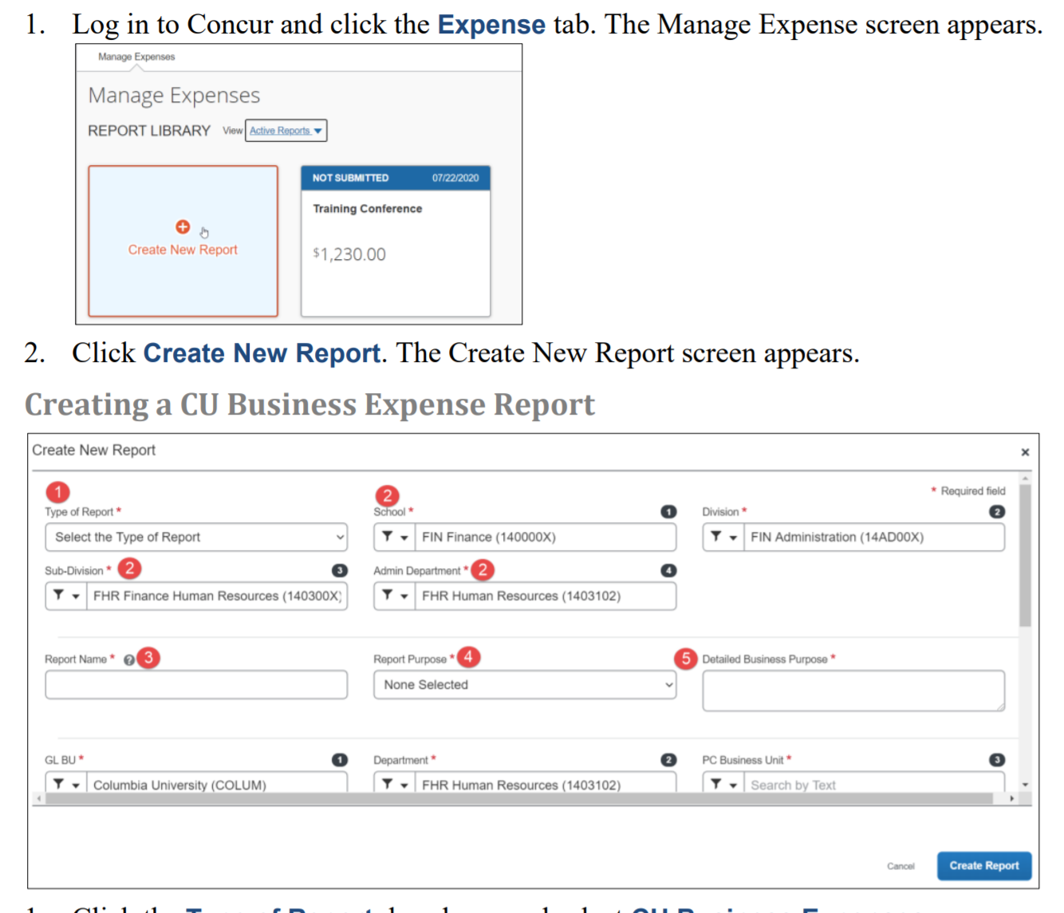

Slide 63
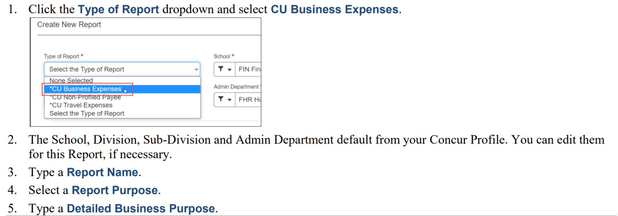

Slide 64
*If you need help with WEAI-related Chartstrings regarding this part of the process, please reach out to Nancy and Ryan for the appropriate information (rm3557@columbia.edu)

Slide 65
Completing a concur expense report
(Travel Expenses)
*All Employees are strongly encouraged to take the Concur Training here. The following information is just a quick guide and a condensed version of the full-training.

Slide 69
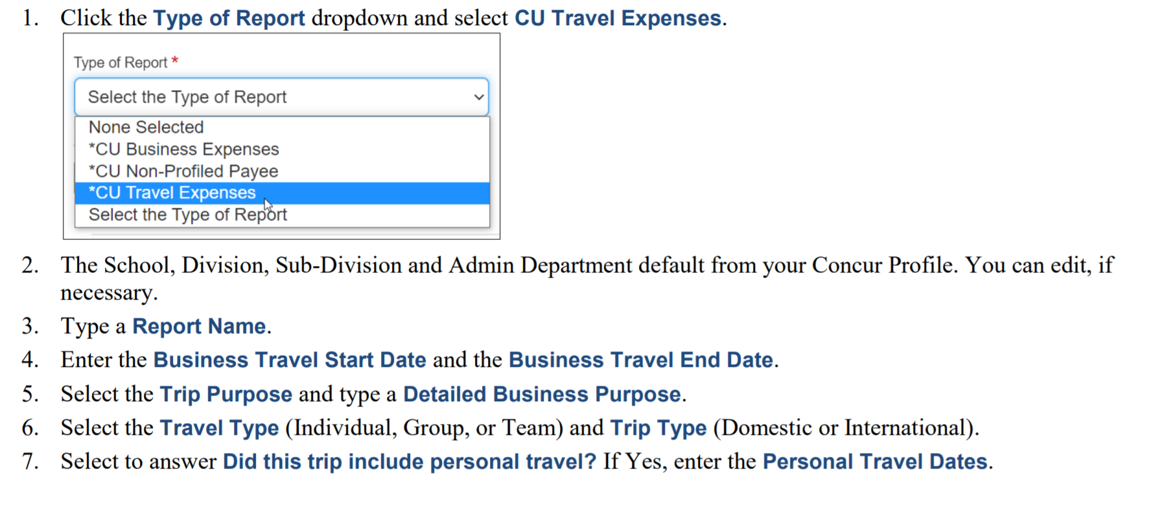

Slide 70
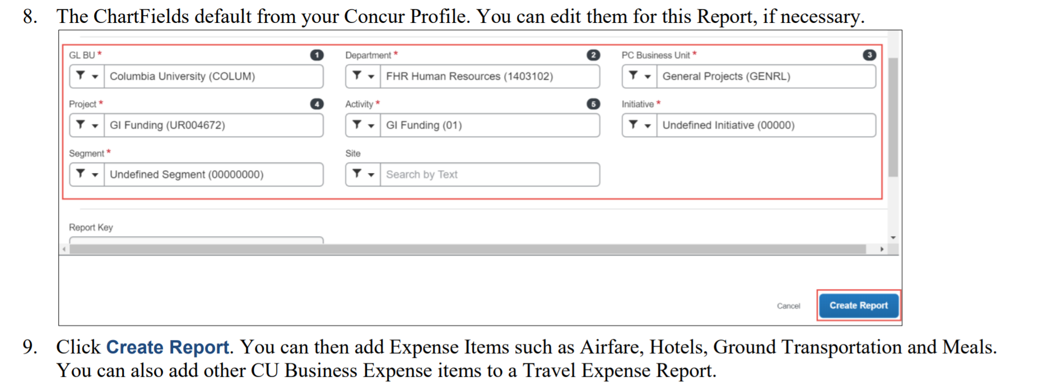
*If you need help with WEAI-related Chartstrings regarding this part of the process, please reach out to Nancy for the appropriate information (nh2047@Columbia.edu)

Slide 71
CREATING AND SAVING FREQUENTLY USED CHARTSTRINGS
*All Employees are strongly encouraged to take the Concur Training here. The following information is just a quick guide and a condensed version of the full-training.

Slide 72
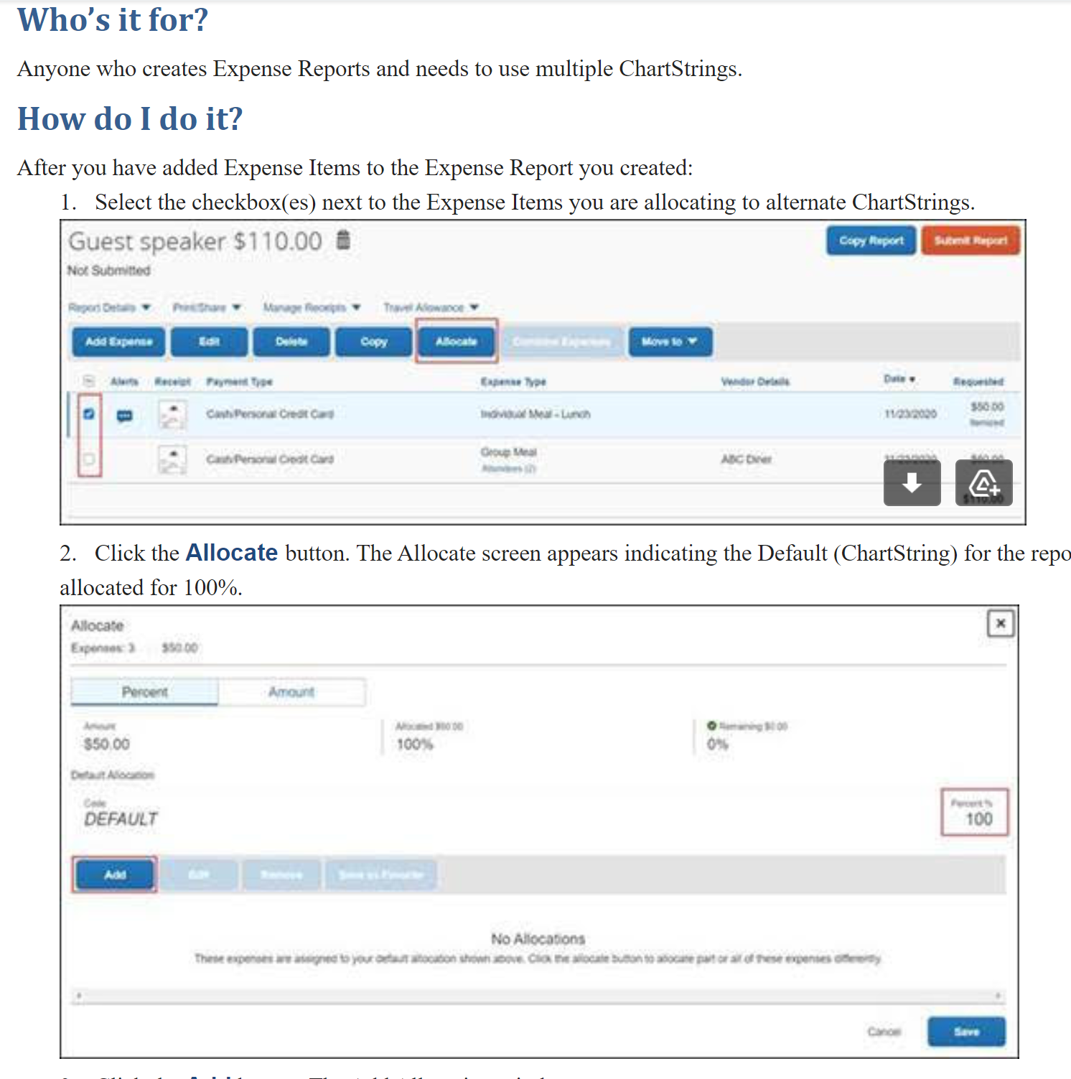

Slide 73
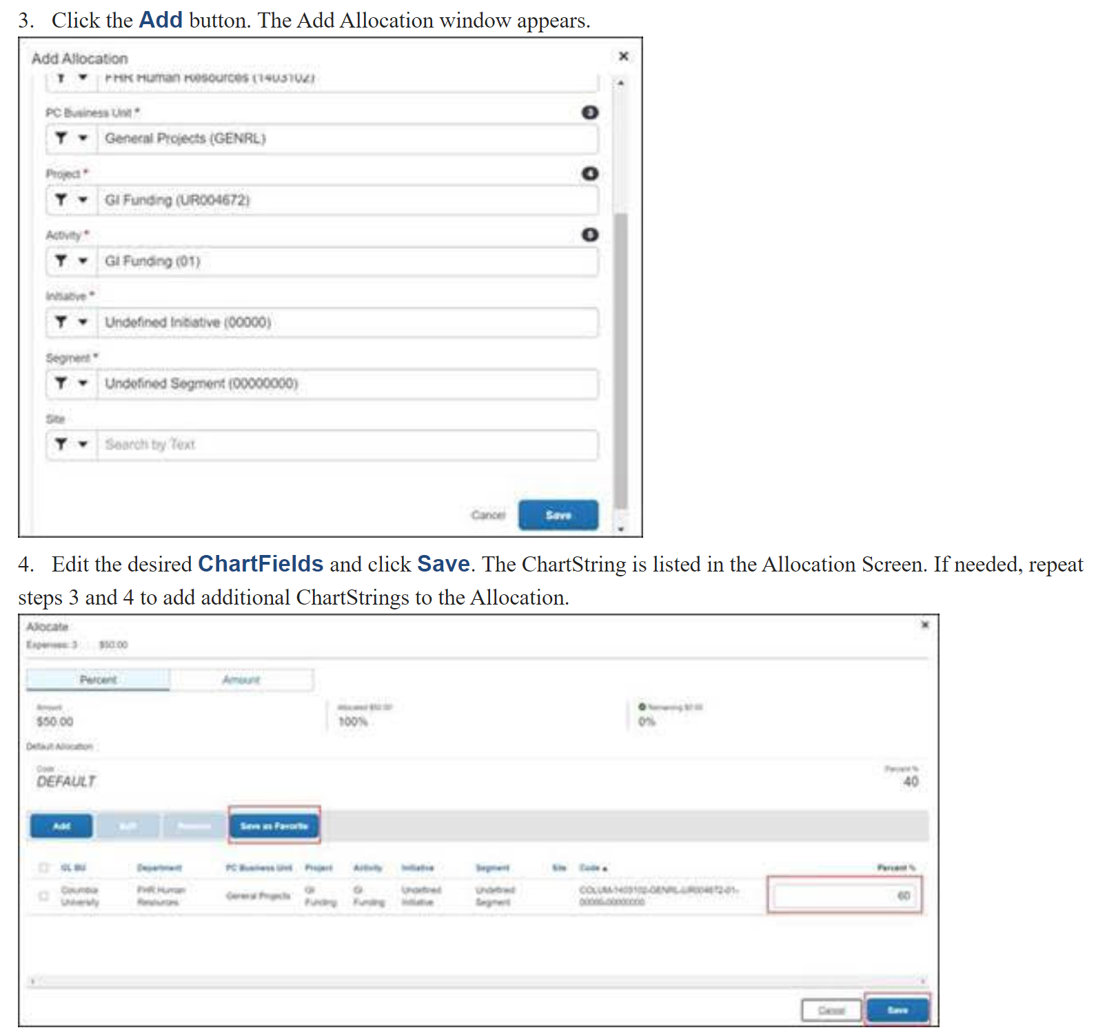

Slide 75
Adding Receipts on concur
*All Employees are strongly encouraged to take the Concur Training here. The following information is just a quick guide and a condensed version of the full-training.

Slide 77
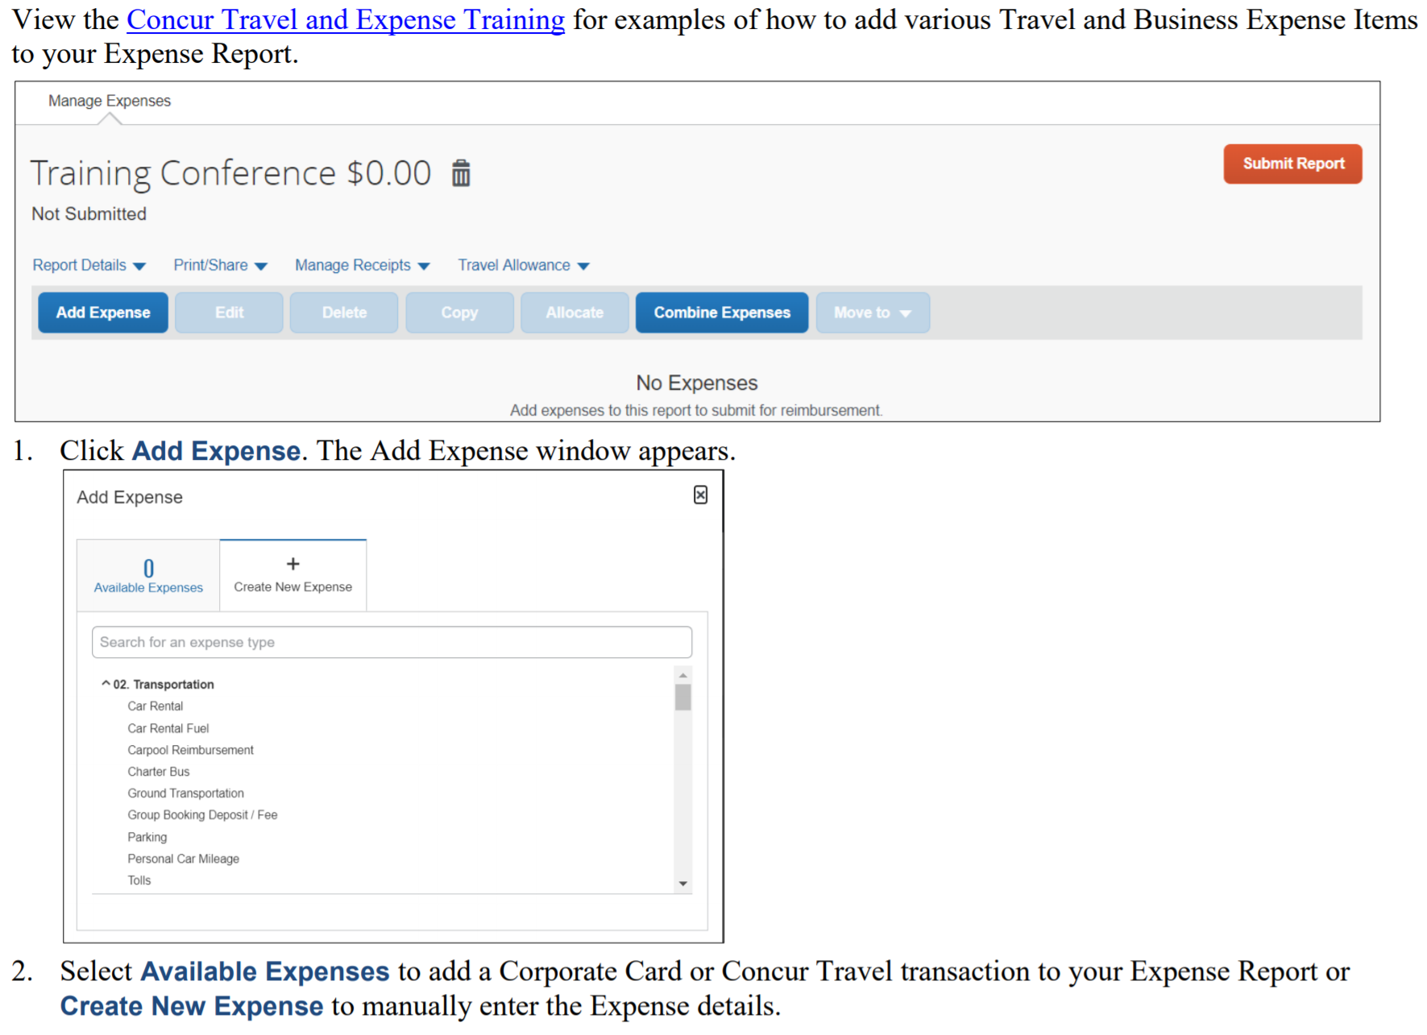

Slide 78
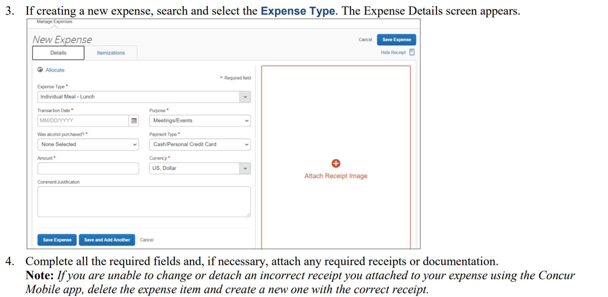
*Instead of uploading the receipt on Concur, you also can email the receipt to receipts@concur.com

Slide 79
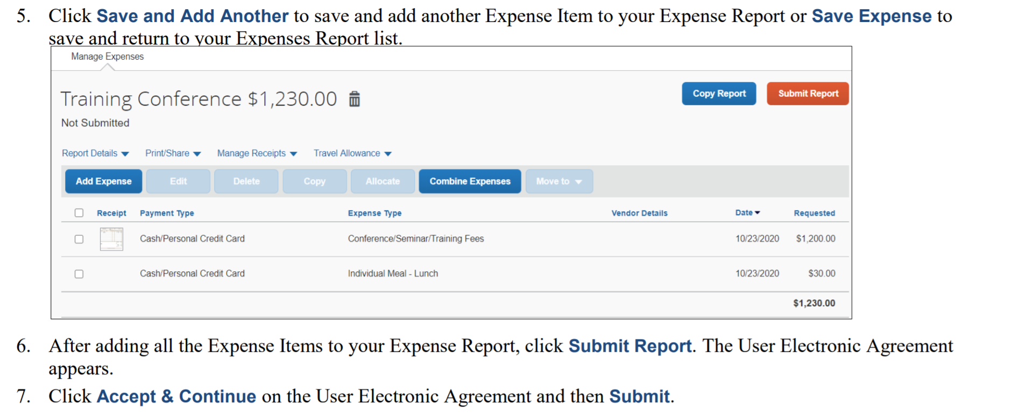

Slide 80
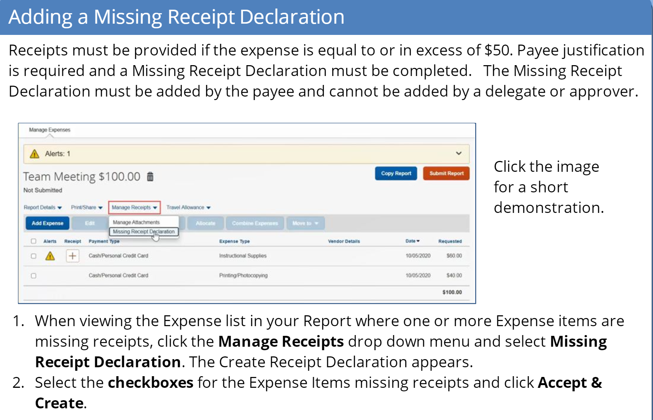

Slide 81
Completing a concur expense report
For a guest or a student
*All Employees are strongly encouraged to take the Concur Training here. The following information is just a quick guide and a condensed version of the full-training.

Slide 82
By default, Students and Guests (Outside Parties) do not have access to Concur. To assist Students and Guests with reimbursable expenses, a Staff member can create and complete a Travel and Business Expense Report on their behalf.
To request reimbursement for a Student or Guest, the user must select CU Non-Profiled Payee as the Type of Report. Please follow our Report Header Guidance when completing the Create New Report screen in Concur. The following worksheet should be completed and included with all CU Non-Profiled Payee reports:
Web Form: Non-Profiled Payee Travel and Business Expense Worksheet

Slide 83
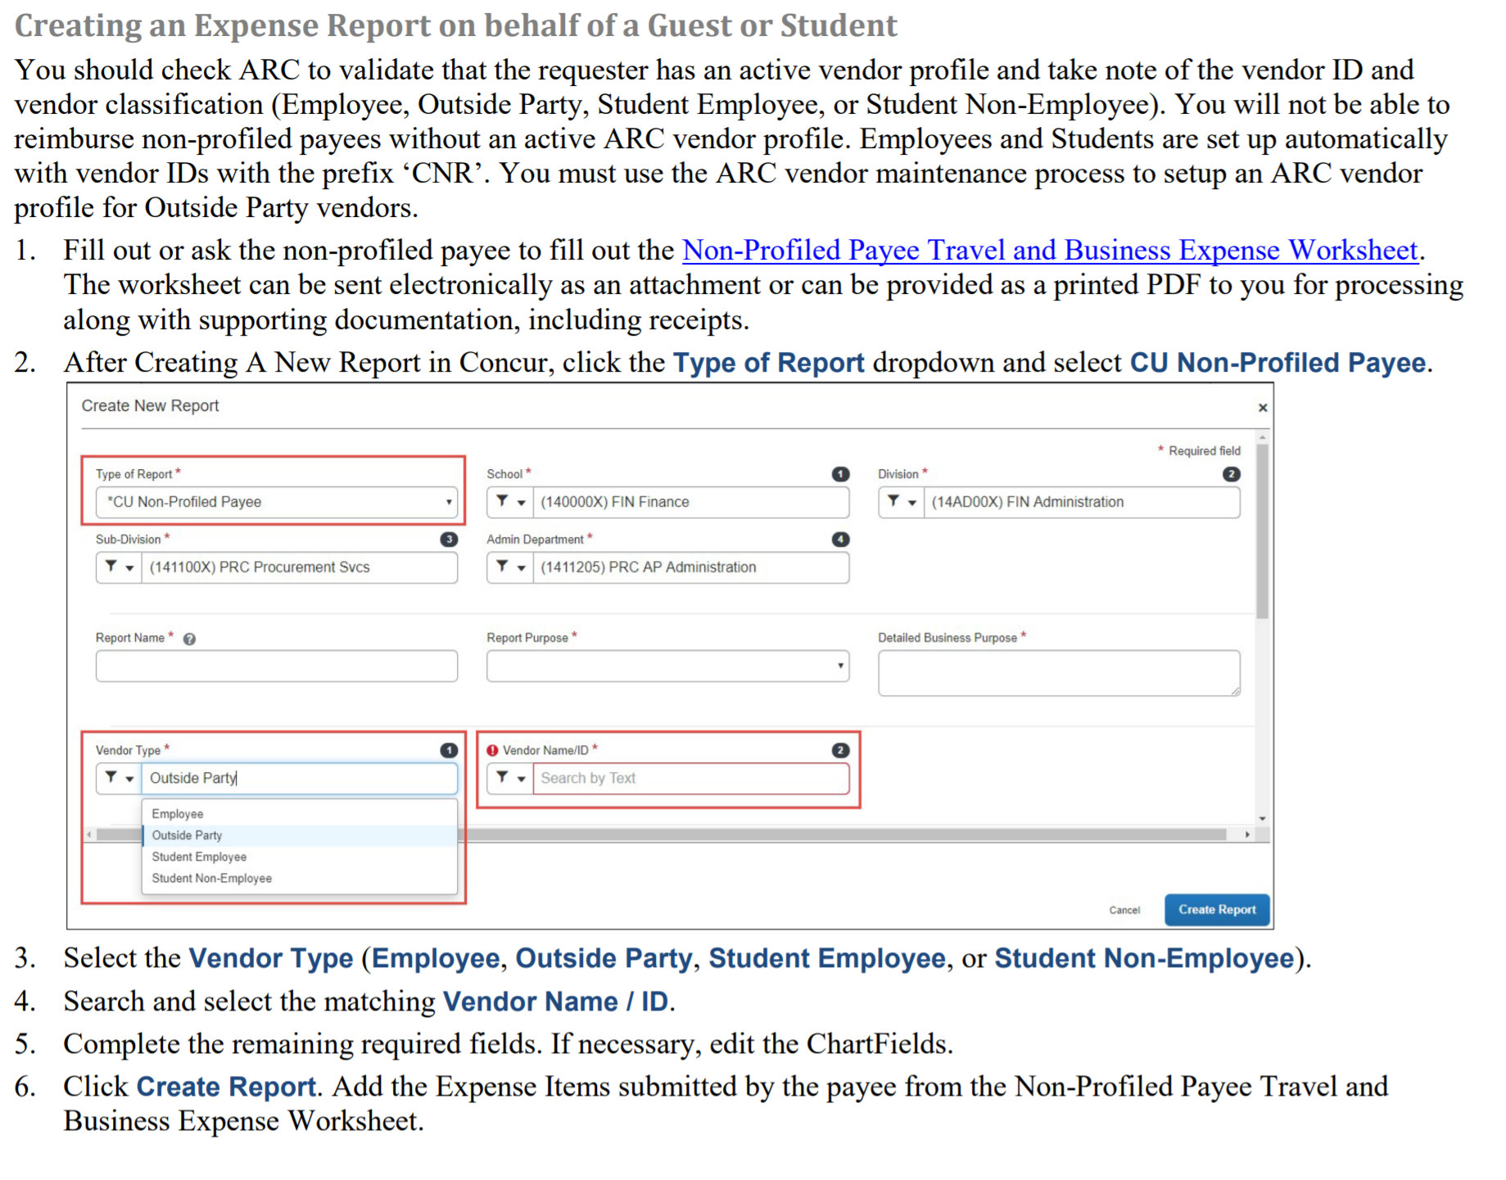

Slide 84
Checking approval status of your report
*All Employees are strongly encouraged to take the Concur Training here. The following information is just a quick guide and a condensed version of the full-training.

Slide 85
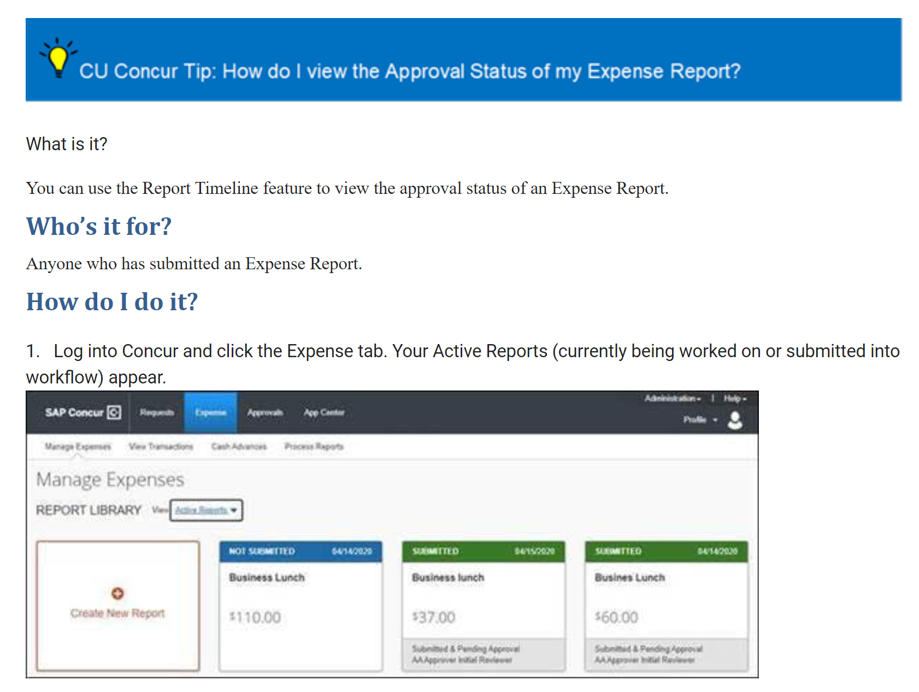

Slide 86
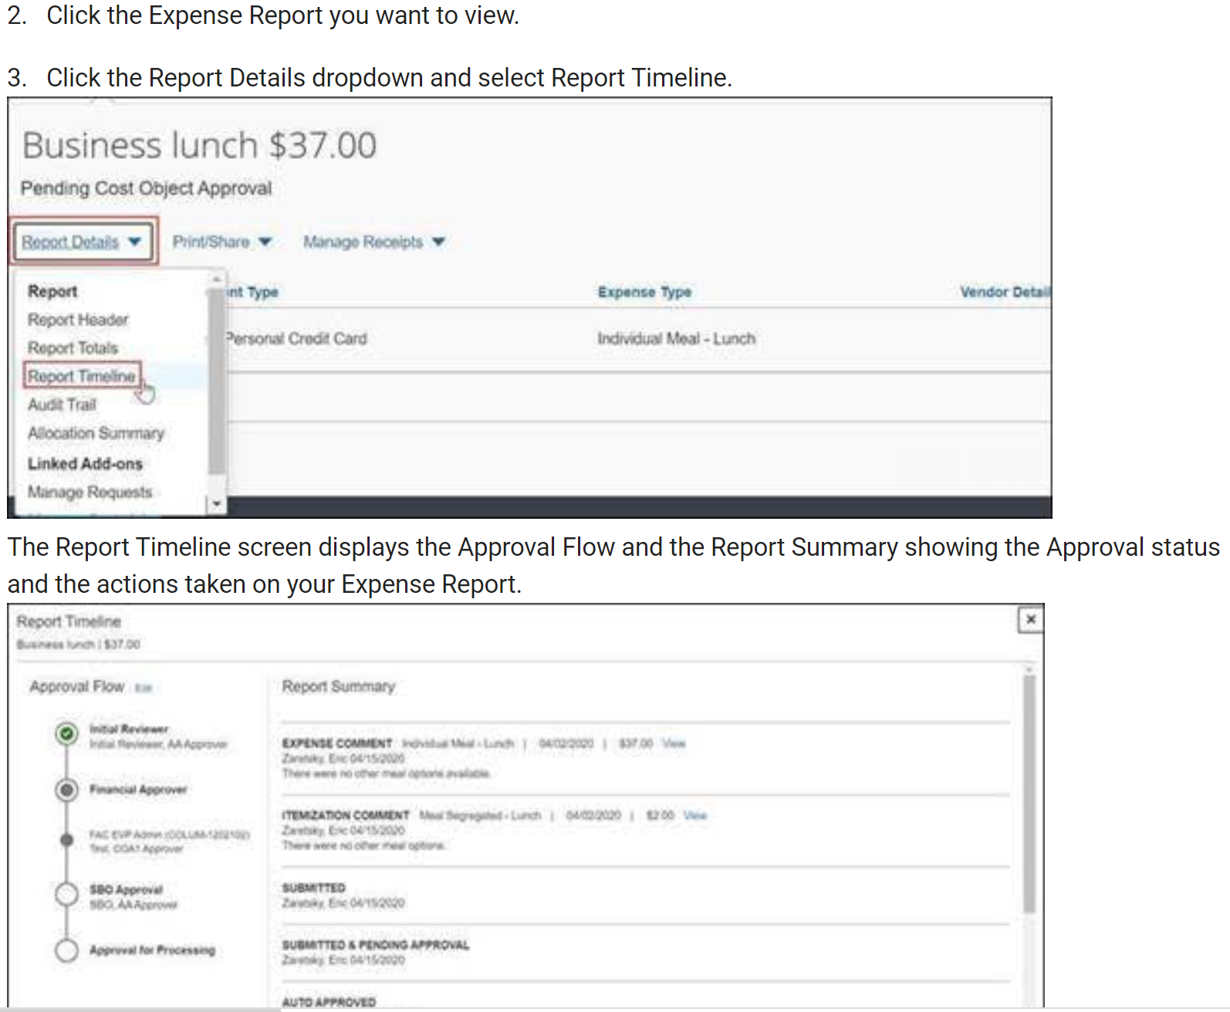

Slide 87
Accessing Concur on mobile
*All Employees are strongly encouraged to take the Concur Training here. The following information is just a quick guide and a condensed version of the full-training.

Slide 88
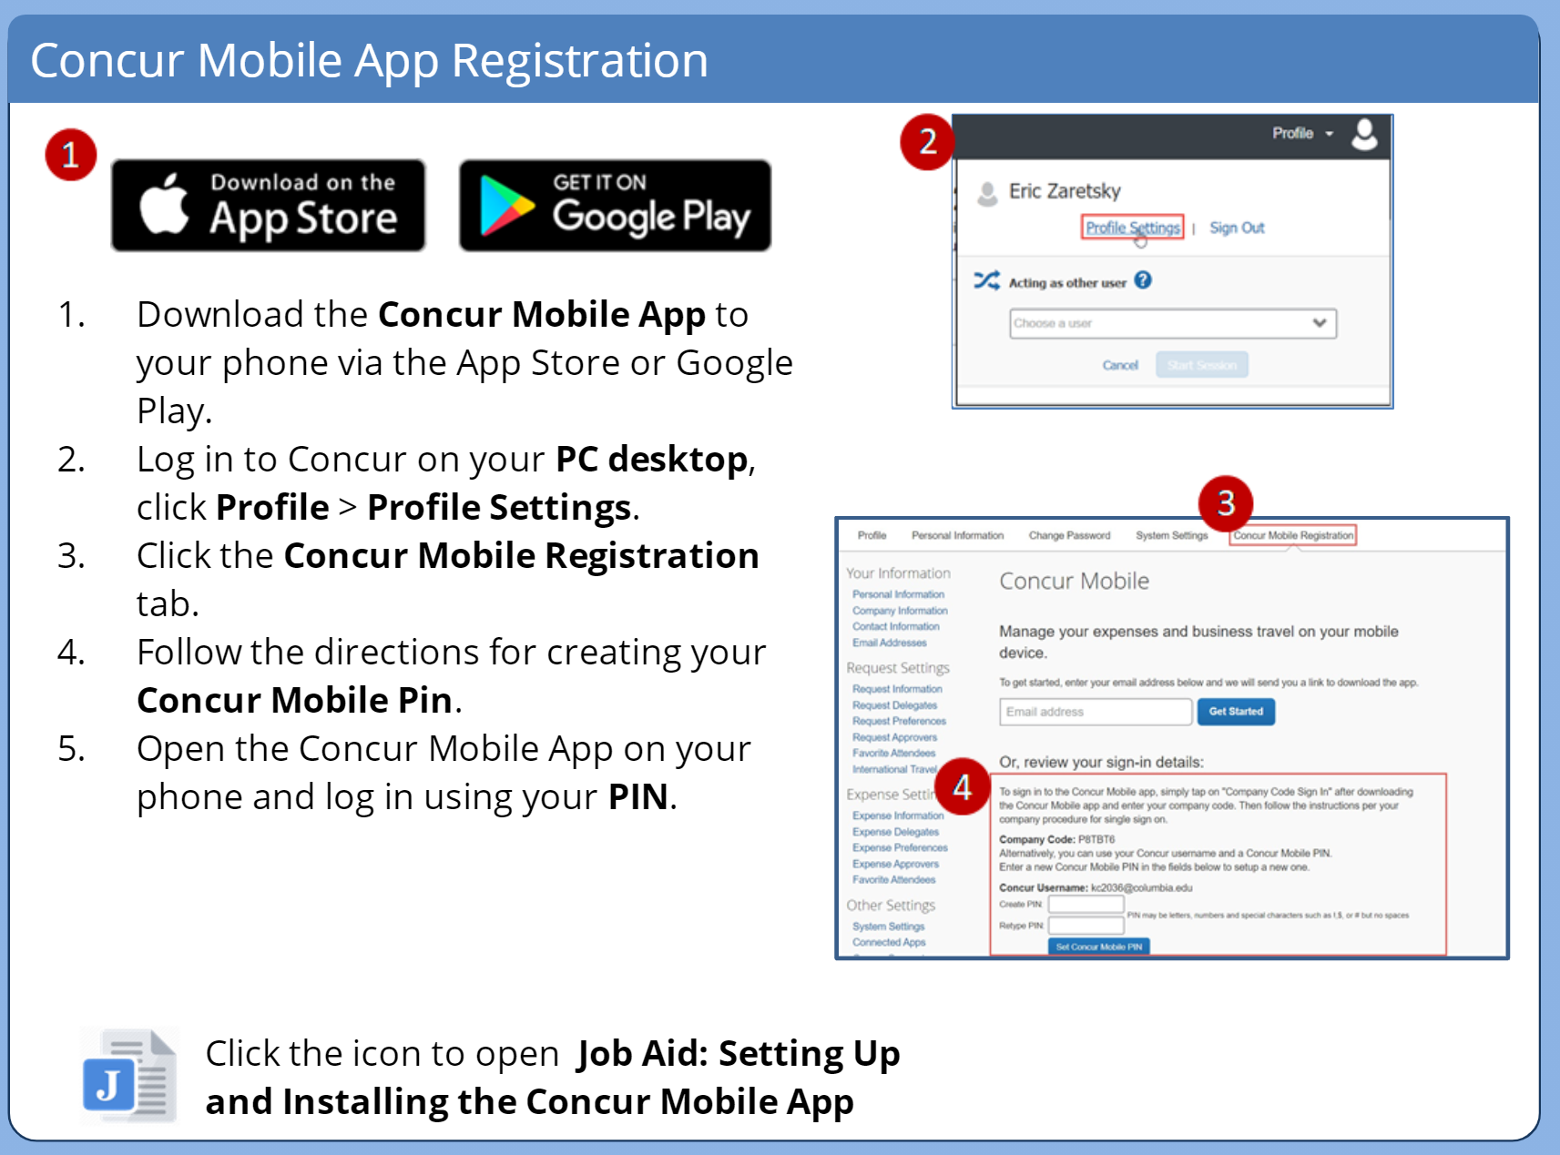

Slide 89
Appendix
All Columbia financial policies and procedures, as well as links to forms and trainings, can be found in the finance gateway. For additional information and full text of policies/ instructions please visit the finance gateway.
Business Expense Policy
Travel Expense Policy

Slide 90
Need help?
Please do not hesitate to contact Nancy should you require assistance.
Additionally, you can contact the Finance Service Center
Alternatively, you can log an incident or request a service via Service Now
All Employees are strongly encouraged to take the Concur Expenses Training here

